Slide 1







THE STRONGEST
FOUNDATION EVER!
Bharath, CEO, Ganesha Holo Bloc
9787 999 099

Slide 2


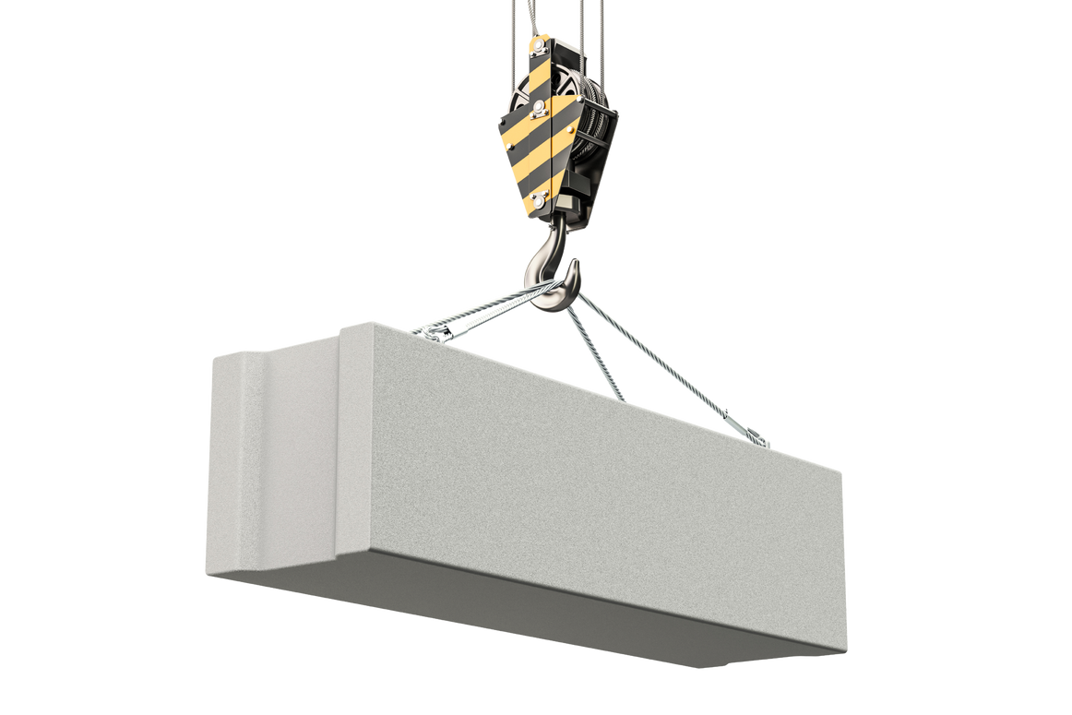
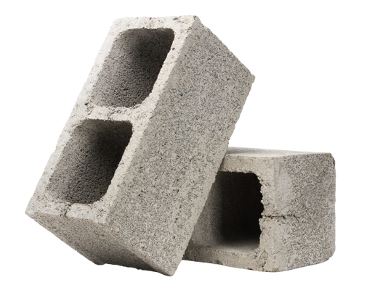
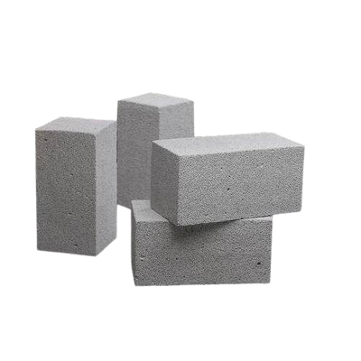
Manufacturer of
hollow blocks
&
solid blocks
since 2006
9787 999 099

Slide 3
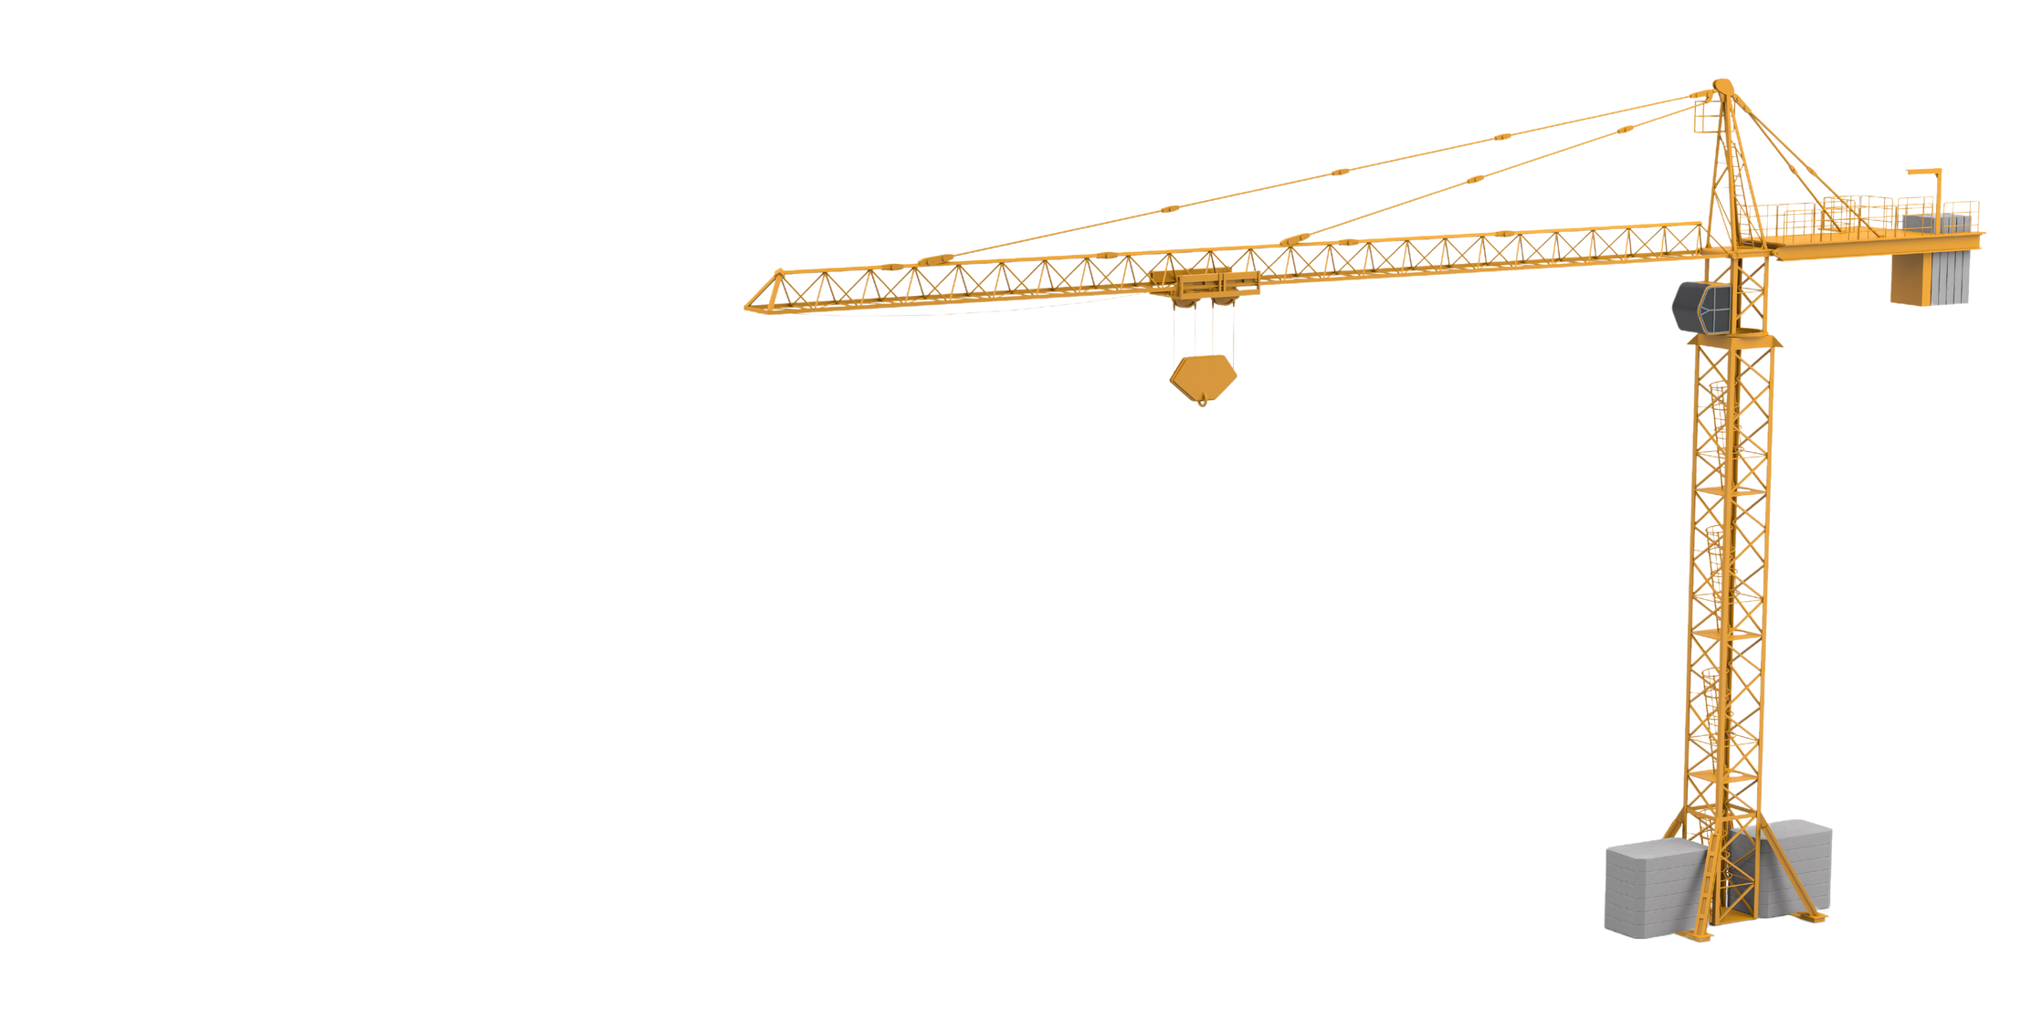

hollow blocks
Hollow Blocks in Construction:
Light Weight, reducing structural load
Excellent insulation properties
Environmentally Friendly
Facilitate wiring and plumbing installations
Good sound insulation, reducing noise pollution
9787 999 099

Slide 4

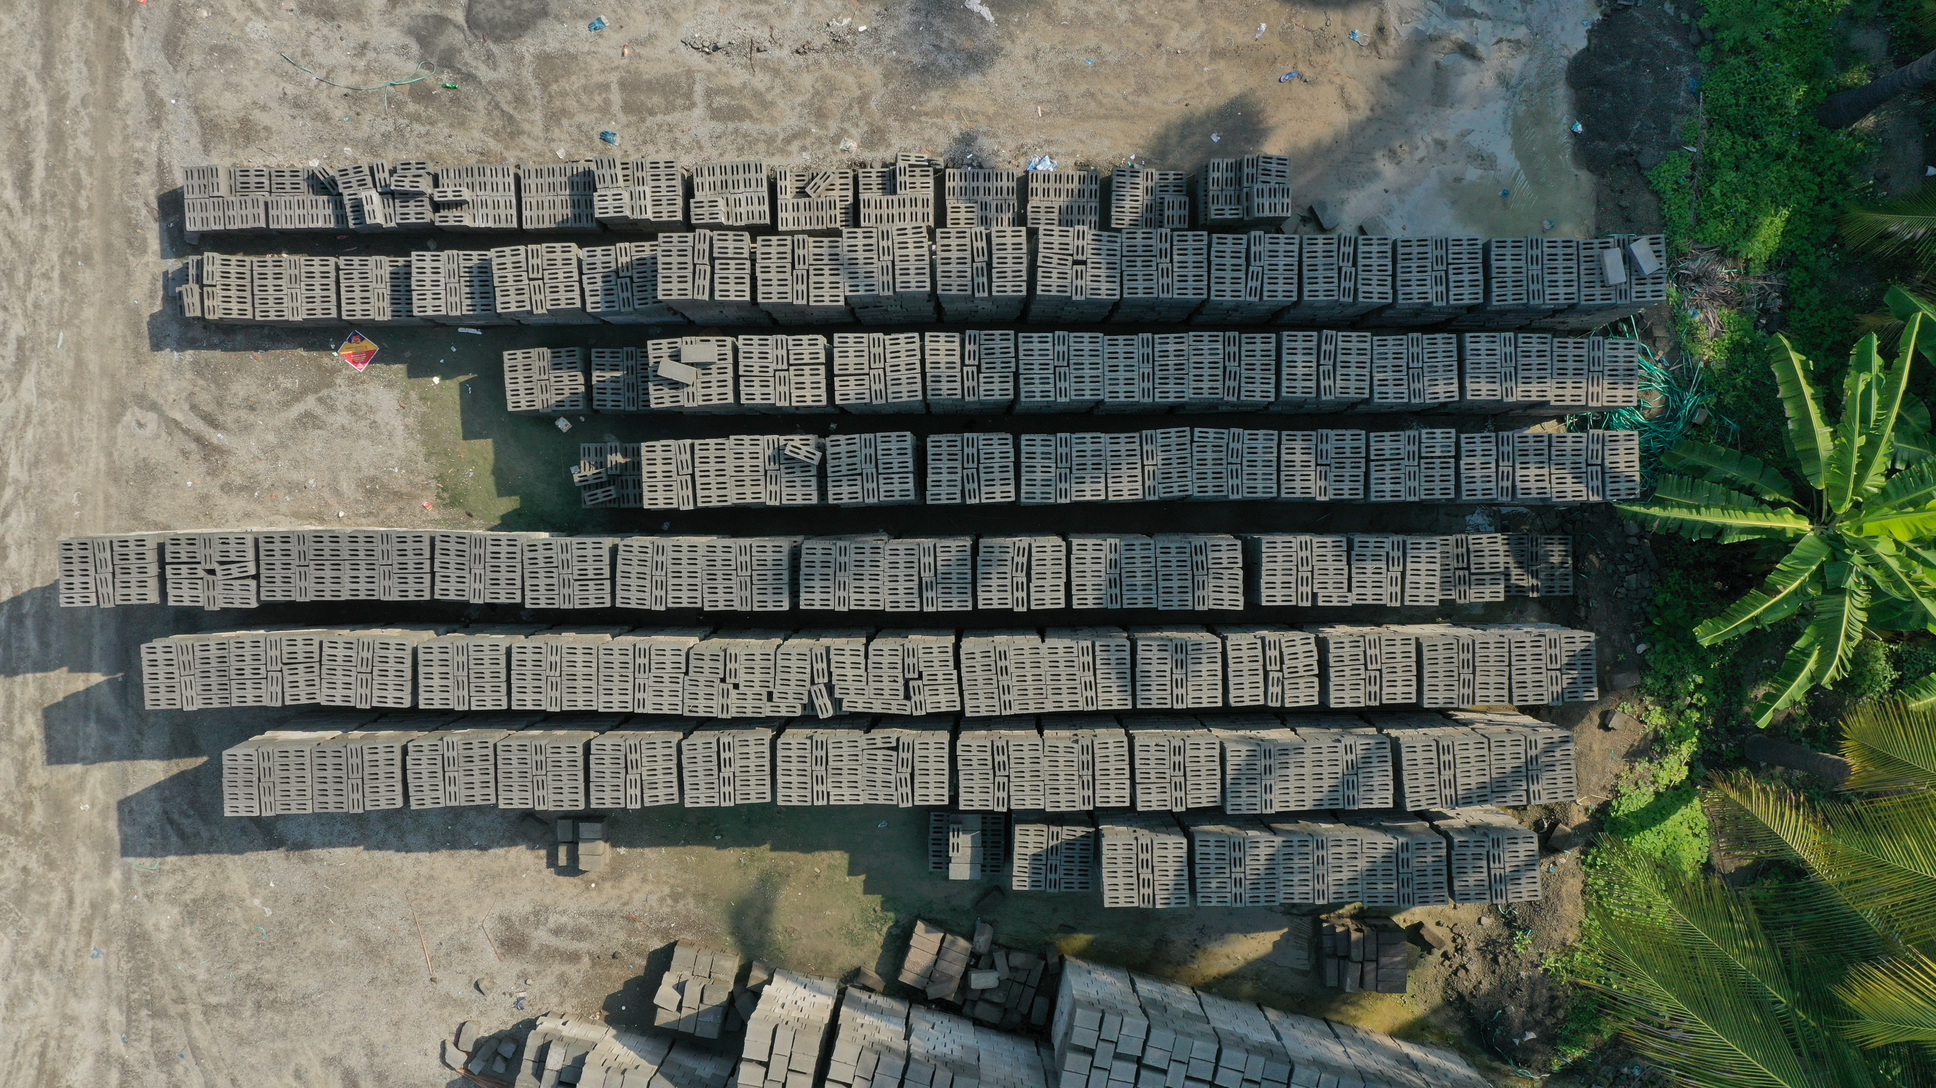
hollow blocks
Available Sizes
L x B x H
15 x 4 x 8
15 x 6 x 8
9787 999 099

Slide 5
hollow blocks applications
Versatile construction materials with various applications known as
Concrete Masonry Units.
Building Walls
Easy stacking, alignment, and stability.
Foundation Construction
durability & load-bearing capacity, ensuring stability and longevity
Partition Walls
Used in residential & commercial spaces to create partition walls without compromising structural integrity.
Retaining Walls
Interlocking blocks are ideal for sturdy retaining walls, offering effective barriers against soil or water due to their design & weight.
Fireproofing
Fire-resistant, ideal for fireproofing like building firewalls to contain & prevent fire spread in buildings.
9787 999 099

Slide 6
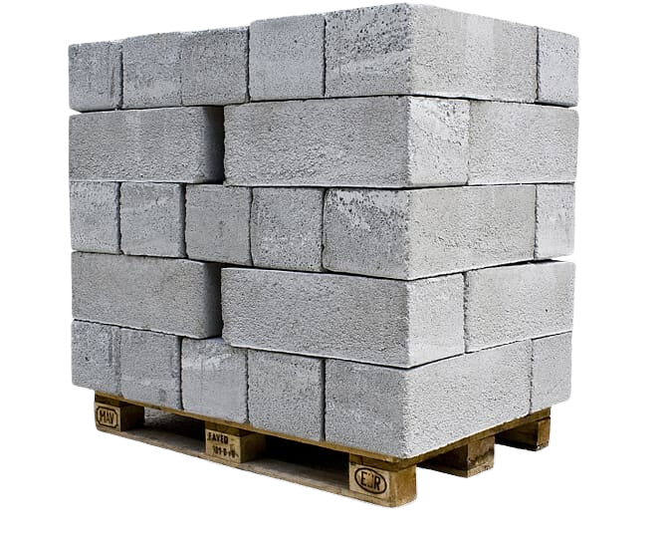
solid blocks
Solid Blocks in Construction:
Offer durability, strength, and versatility
Provide structural integrity for robust buildings
Offer thermal insulation for energy efficiency
Resistant to weathering, pests, and fire for safety
Facilitate faster construction and are environmentally
friendly as they can be recycled.
9787 999 099

Slide 7
solid blocks
Available Sizes
L x B x H
15 x 4 x 8
12 x 8 x 8
12 x 6 x 8
12 x 9 x 8
9787 999 099

Slide 8
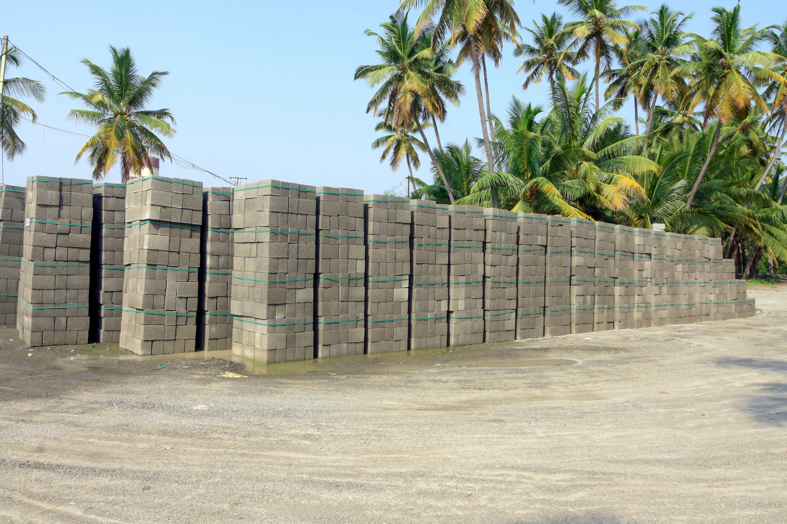
solid blocks applications
Solid blocks are durable and versatile, and widely used in construction
Building Foundations
Provide stability and support heavy loads
Retaining Walls
Prevent soil erosion and create level areas on slopes
Load-Bearing Walls
Support structures to prevent collapse.
Paving & Hardscaping
Durable for driveways, walkways, and patios.
Fireplaces & Chimneys
Fire-resistant for safe and long-lasting construction.
9787 999 099

Slide 9

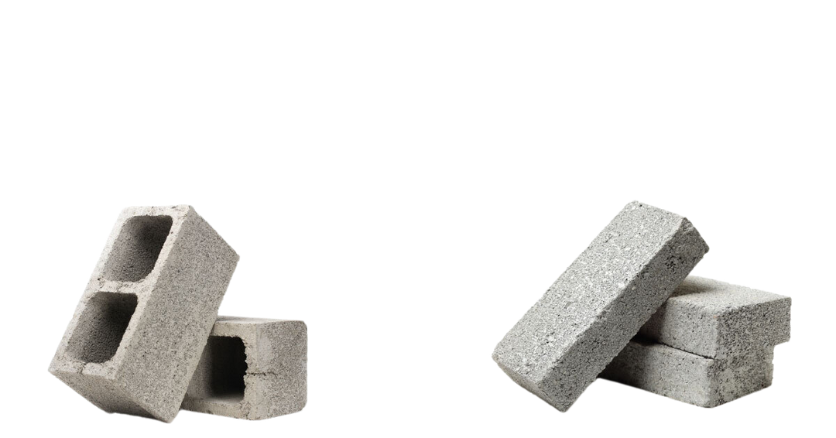
hollow blocks
solid blocks
Hollow in Nature & Less in Weight
Solid in Nature & More in Weight
Conductivity of heat is low (more thermal insulation)
Conduction of heat is high
(less thermal insulation)
It provides a facility to
conceal conduits etc.
It doesn’t provide a facility to conceal conduits etc.
Fine aggregate is more
(as high as 60%)
No fine concrete is preferred.
Needs richer mix
Lean mixes are used
9787 999 099

Slide 10
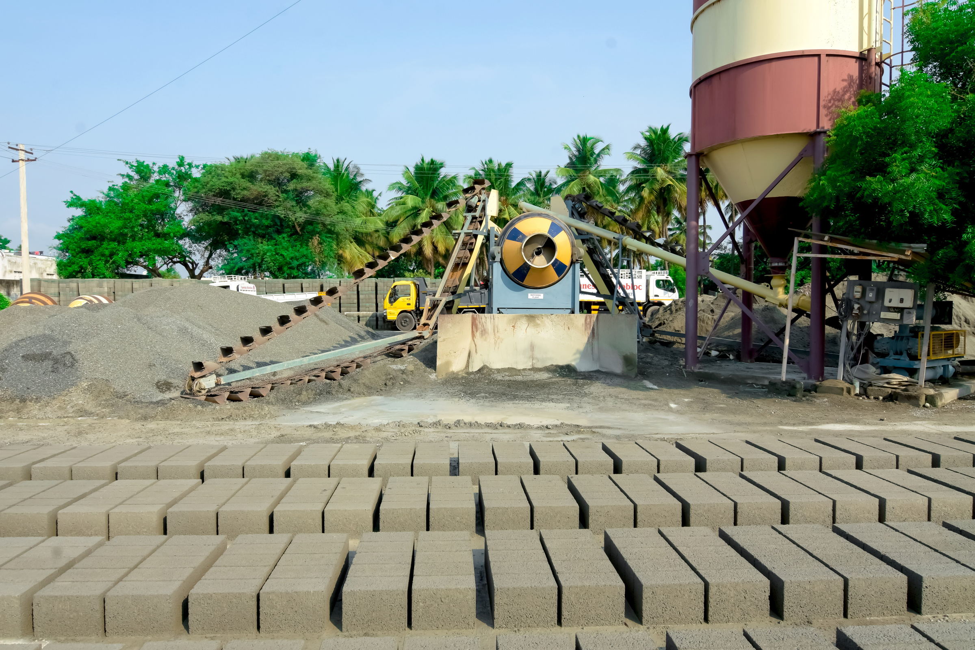
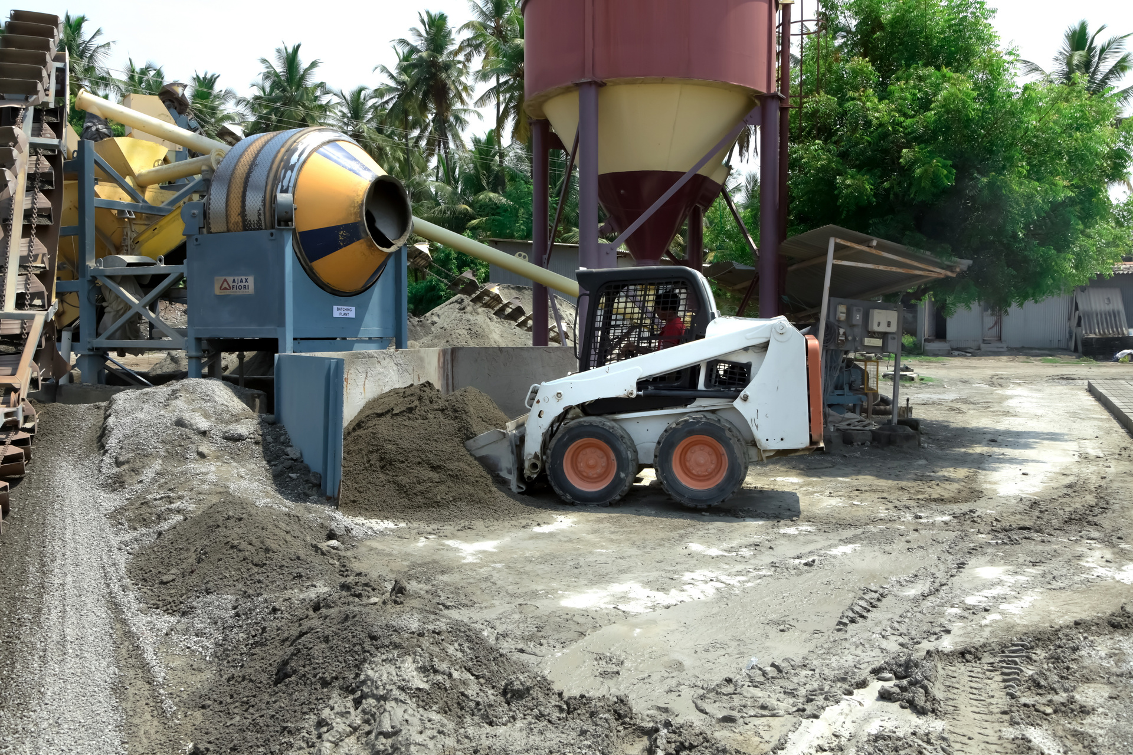
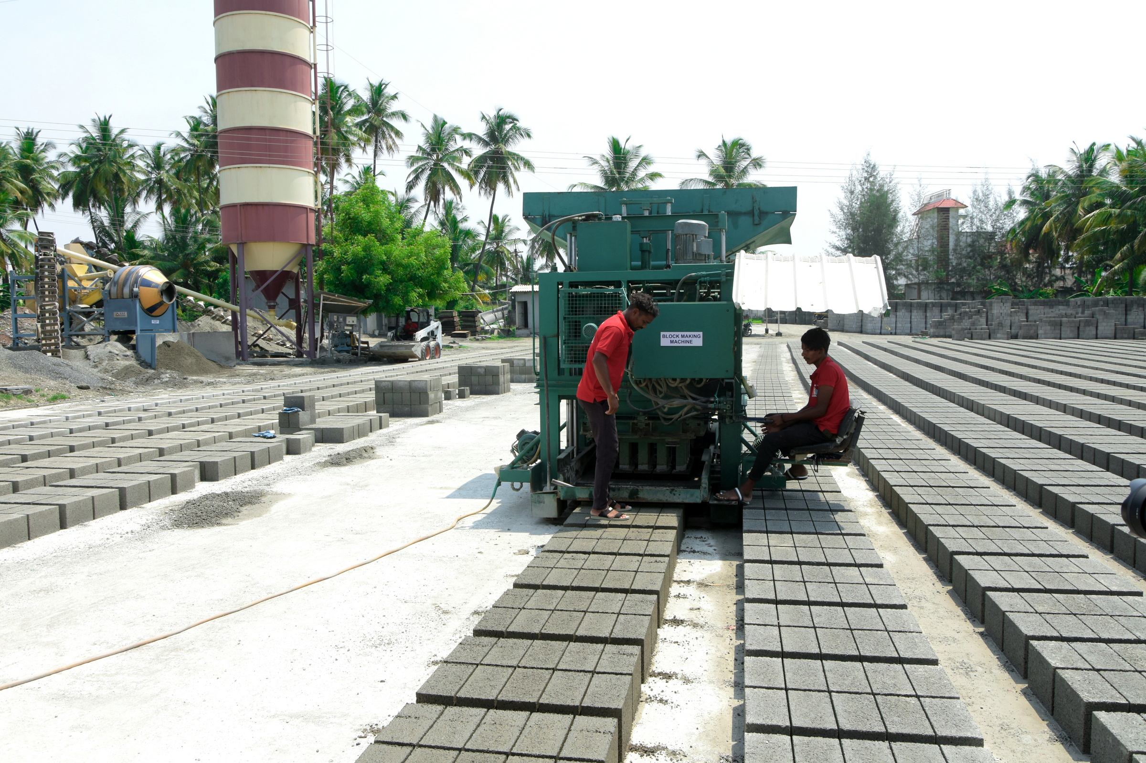
manufacturing unit
Manufacturing the long-lasting hollow blocks & solid blocks
9787 999 099

Slide 11
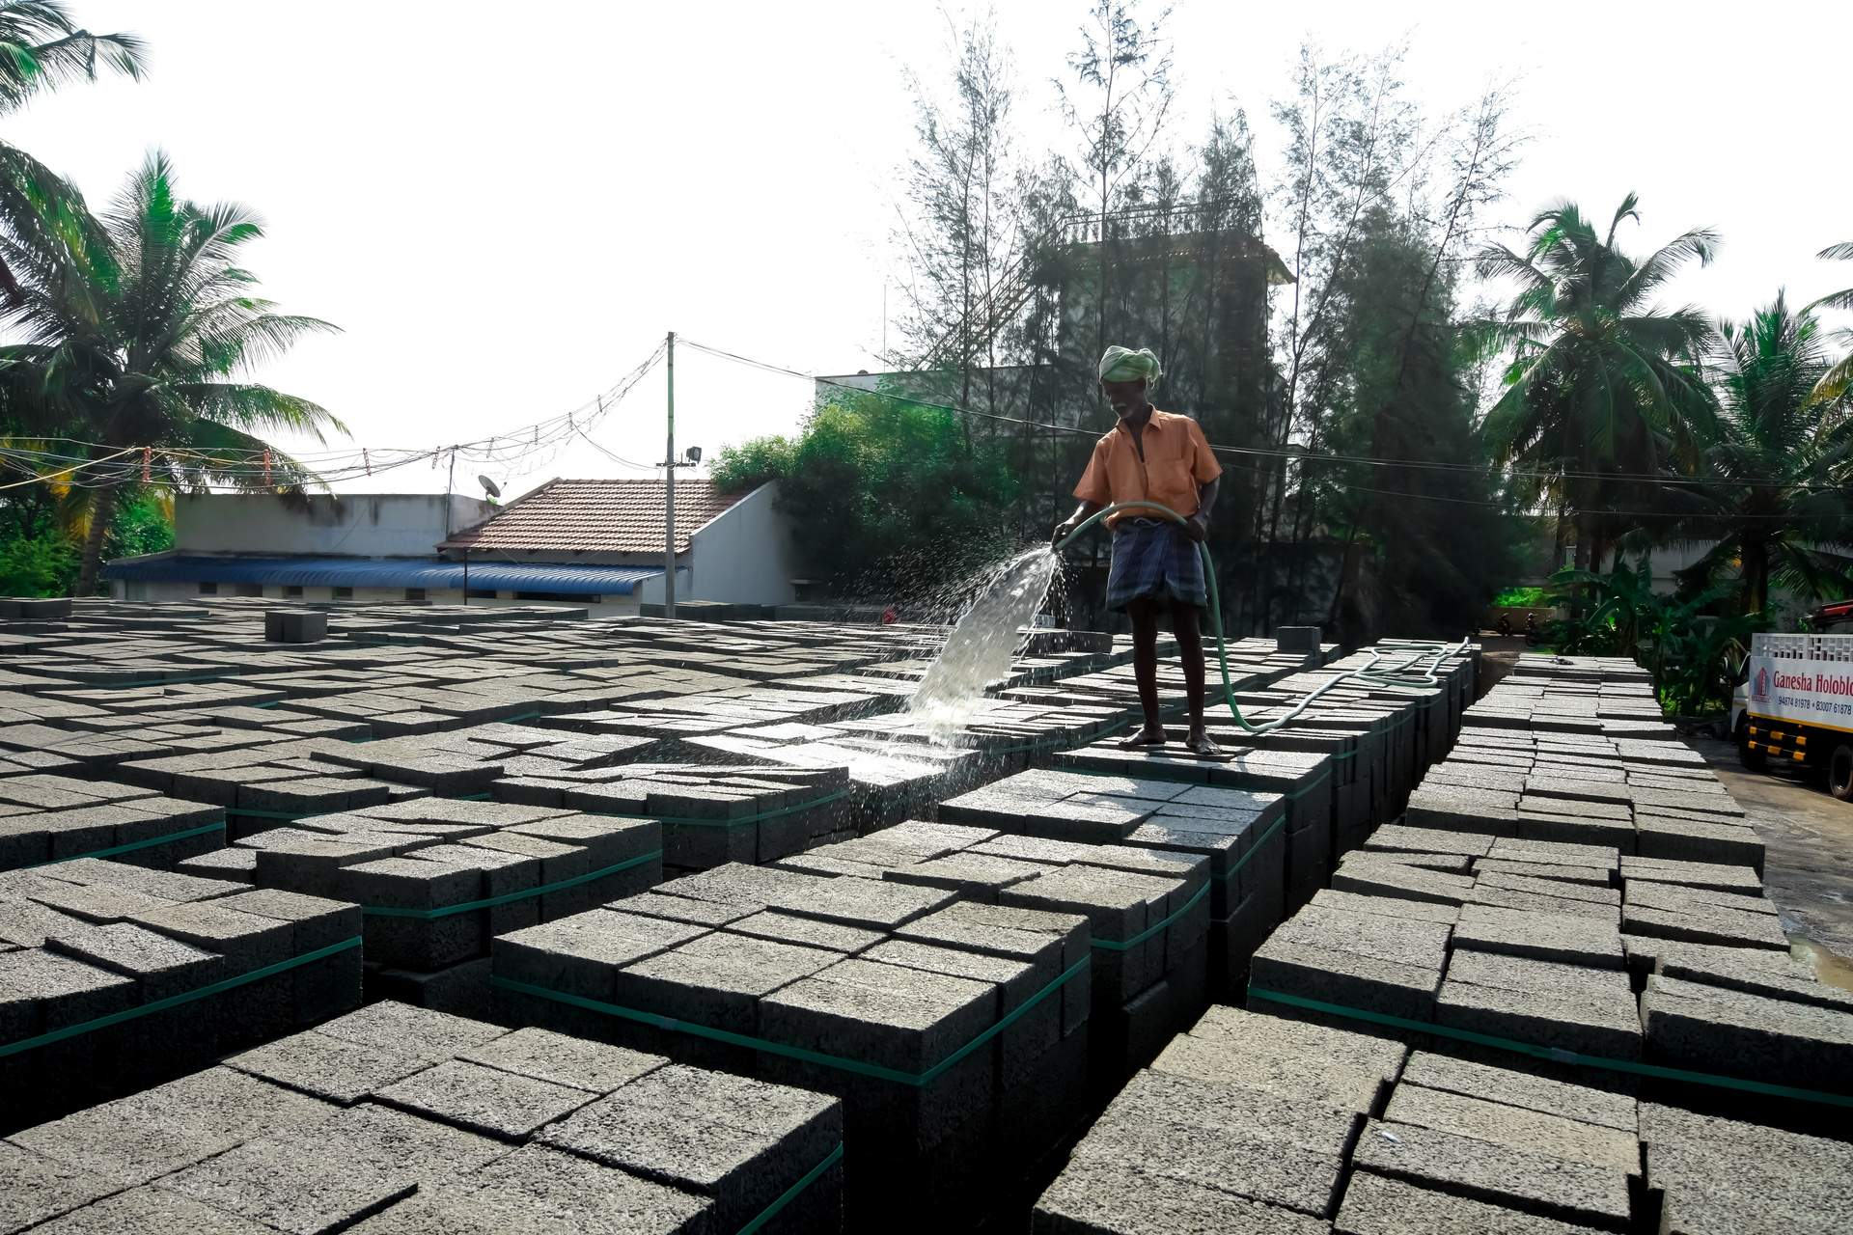
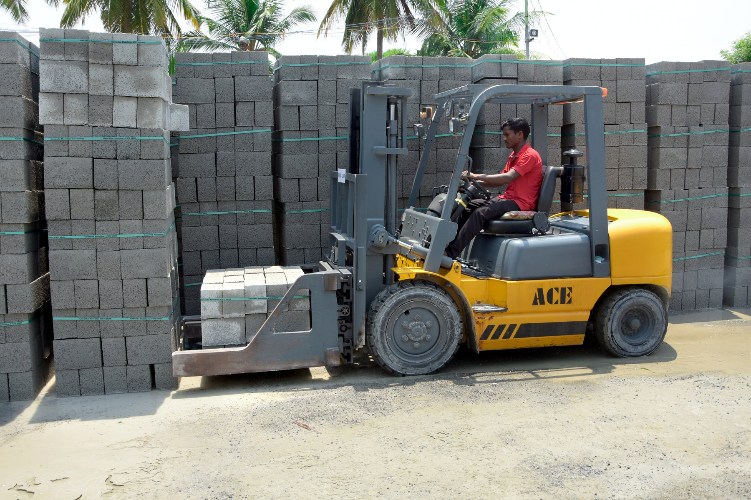
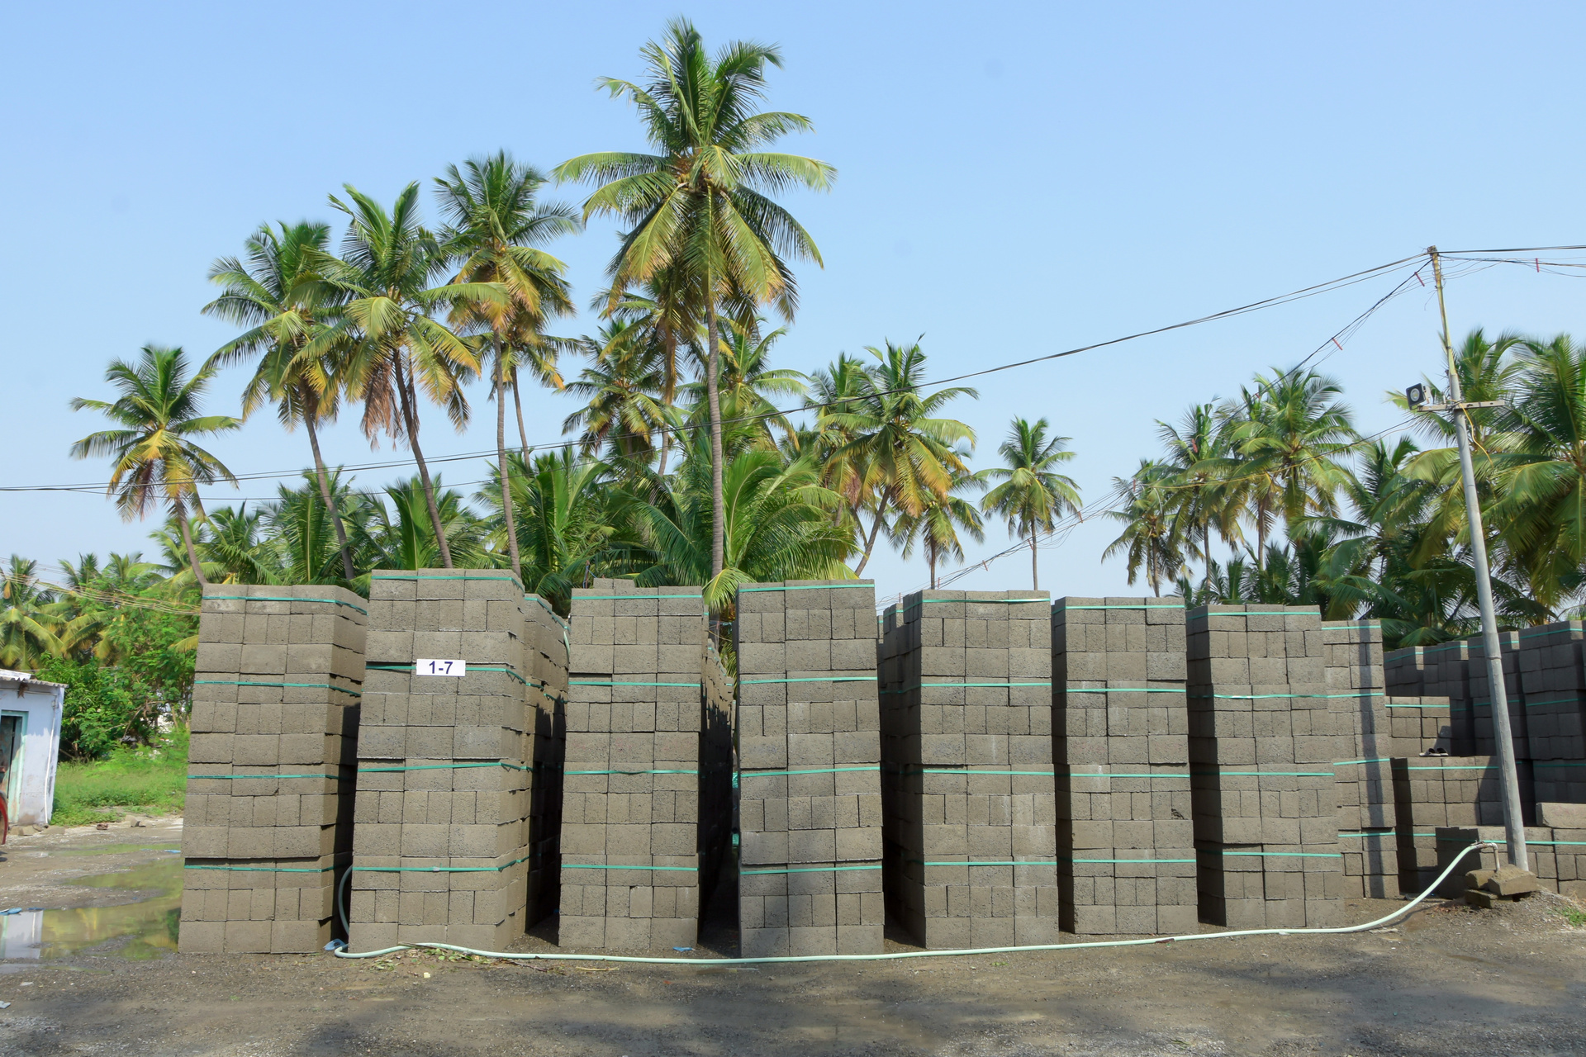
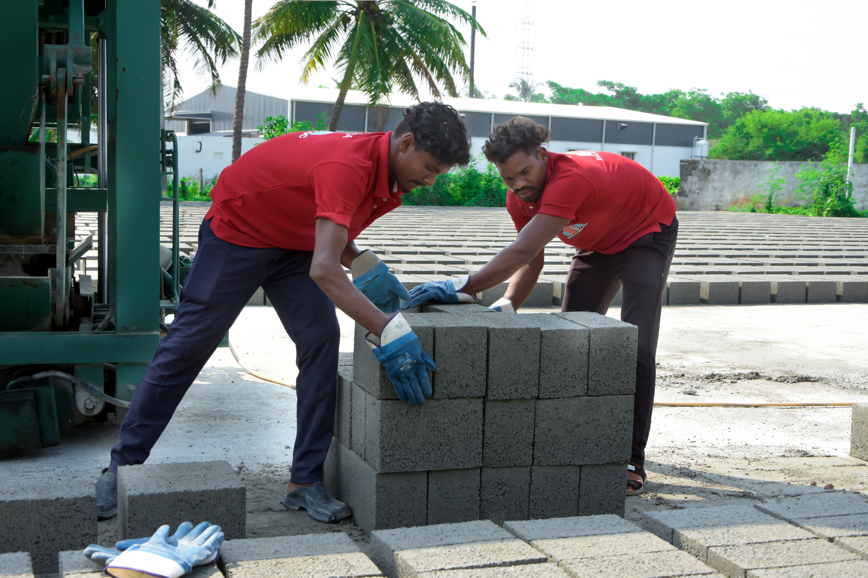
manufacturing unit
Solid blocks are durable and versatile, and widely used in construction
Bundling
9787 999 099

Slide 12
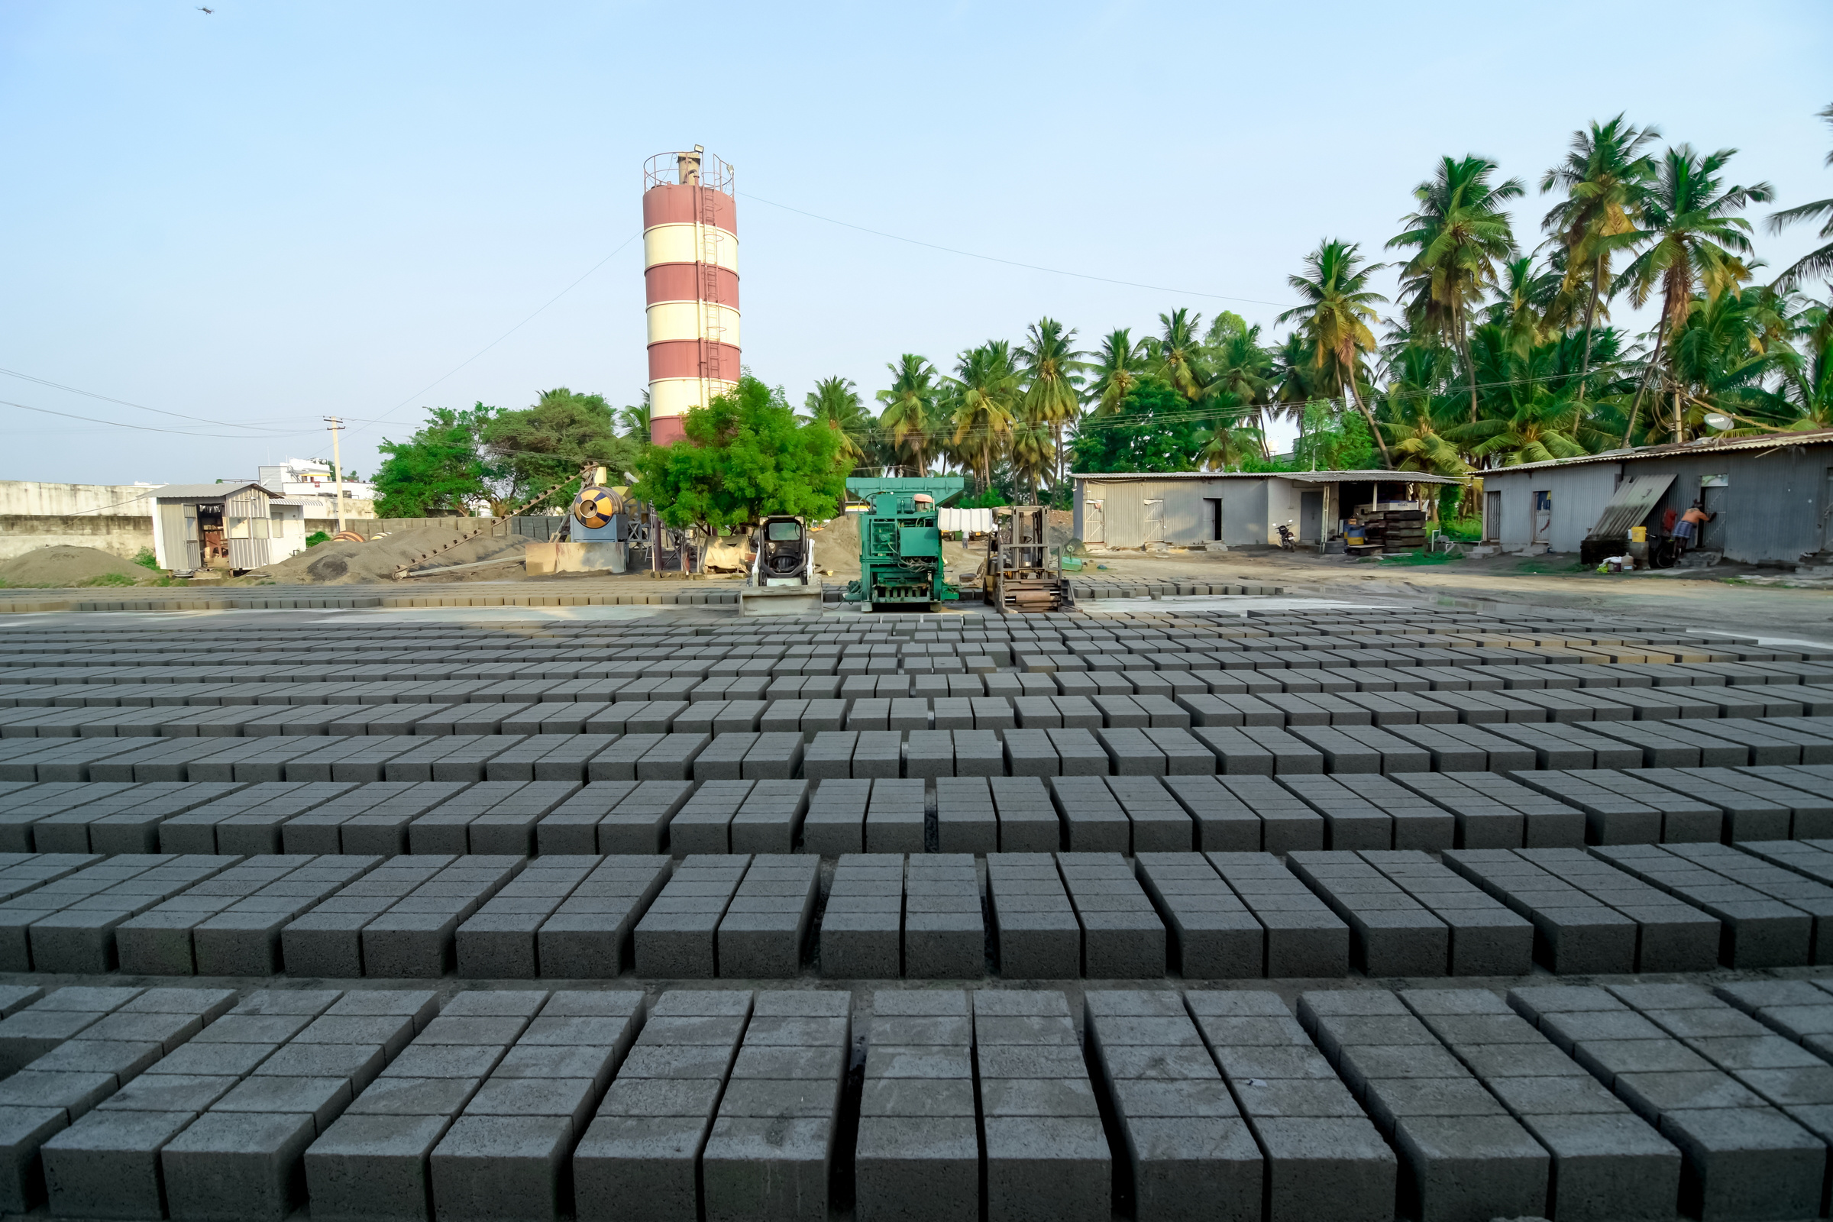
Production capacity
Solid blocks are durable and versatile, and widely used in construction
Production / Day
7,500 blocks will get ready in our plant
Mixing
Reversible Drum with Batching Plant
Raw Material
6mm blue metal
Cussr Dust
Cement
9787 999 099

Slide 13
manufacturing process
Raw Materials Acquisition
Mixing
Forming the Blocks
Curing
Demolding
Drying
Quality Control
Packaging and Storage
Distribution
9787 999 099

Slide 14
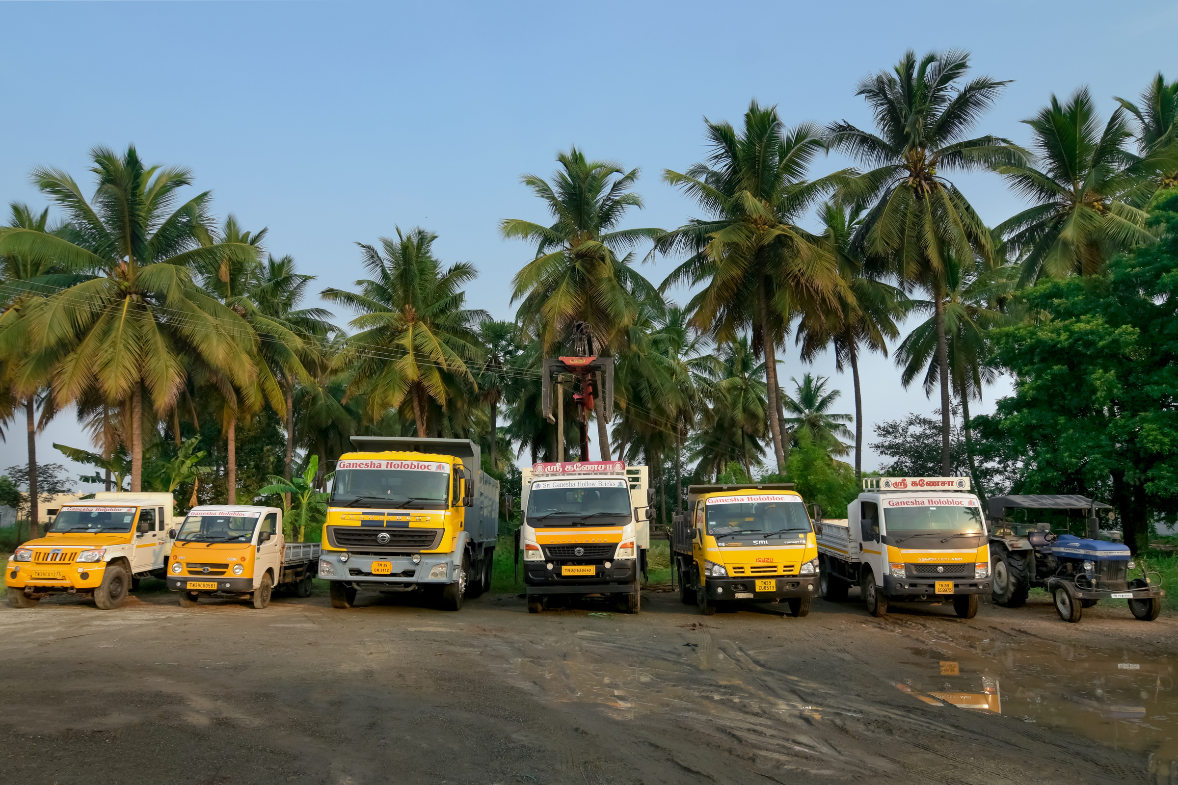
transportation
Providing Quality Transportation service for all your hollow blocks & solid blocks
9787 999 099

Slide 15
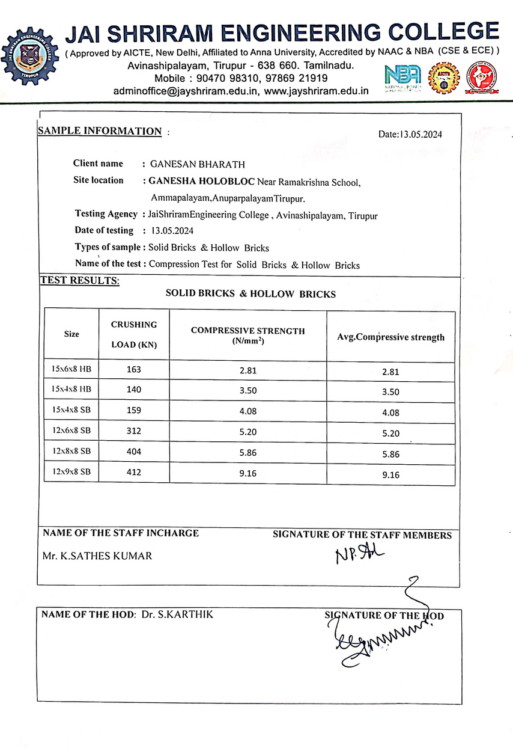

lab tests
Conducting lab tests on hollow block manufacturing to check quality & durability
Assess materials like cement, sand, aggregates, and mix proportions.
Test blocks for compressive strength, water absorption, and
dimensions to ensure they meet construction requirements.
The goal is to produce high-quality, durable blocks for safe and sustainable building practices.
9787 999 099

Slide 16

vision & mission
Vision
Striving to be a leader in eco-friendly construction materials, setting industry standards in innovation & sustainability.
Mission
Delivering cost-effective solutions for safe, sturdy, energy-efficient structures, contributing to society and the environment.
9787 999 099

Slide 17
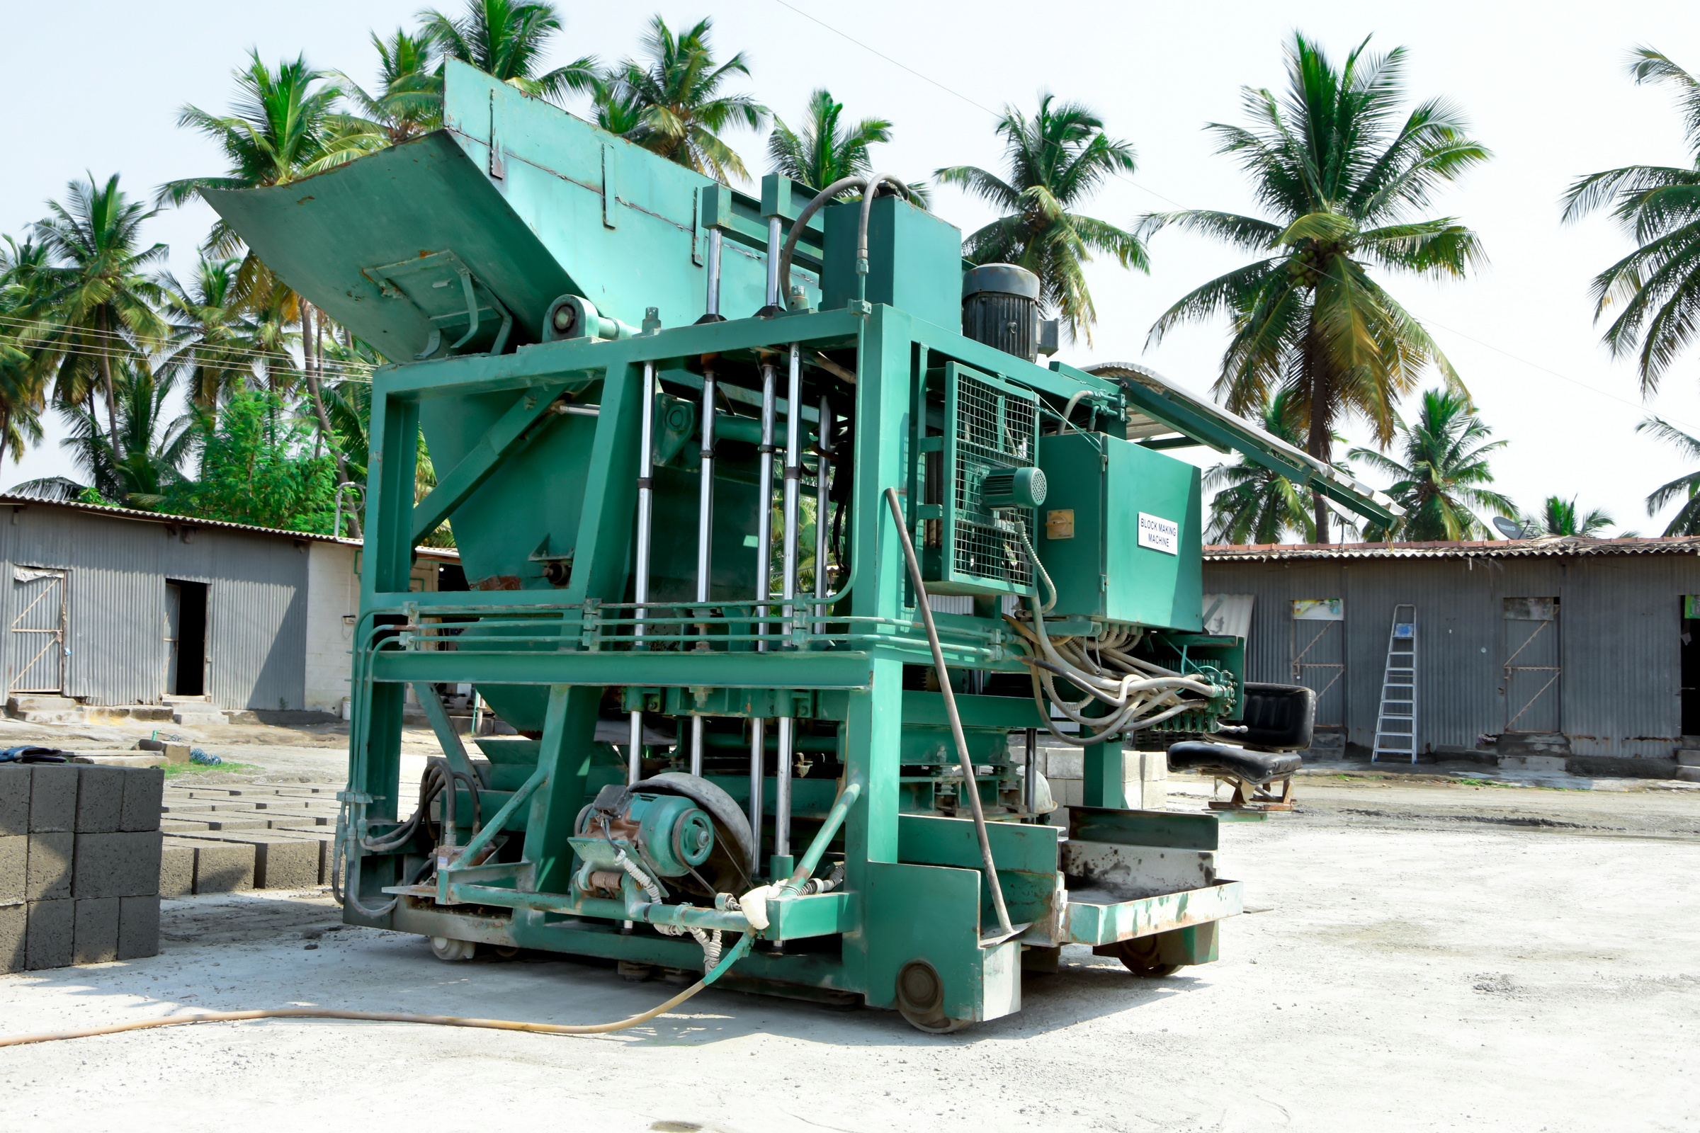
why we are?
Crafting high-quality blocks using advanced technology, with a focus on customer satisfaction & community involvement.
Being a reason behind the Strongest Foundation ever!
9787 999 099

Slide 18
our valuable clients
KGISL
PSG (Revantha)
⁠Chathamkulam Projects
⁠Jain Housing
⁠Kailash Traders Group
SRG APPARELS
Spictex
Sri Ram Auto Mall
9787 999 099

Slide 19
Good REFERENCEs
B to C Category
B to B Category
Engineers
Architects
Mestri
Construction Companies
Promoters
Block manufacturers
⁠Hardwares
⁠Building Material Suppliers
9787 999 099

